Slide 1
SDN – Software Defined Networking

Slide 2
Learning objectives
Understand the difference between traditional networking and SDN
Learn SDN architecture and key components
Explore SDN controllers and protocols
Simulating/experimenting with SDN
Discuss challenges and future directions

Slide 3
Why SDN ?
Traditional networks are hardware-centric and vendor-specific
Complex to configure and scale
Slow to respond to changes or failures
SDN enables programmability, automation, and centralized control

Slide 4
Traditional vs. SDN Networking
Traditional:
  distributed control plane, manual configuration
  static, complex architecture
  Inconsistent policies
  inability to scale
  vendor dependence
SDN:
  centralized control plane, software-defined policies
  decouples control plane and data plane
  adaptability and maintainability
  automation
  on-demand scaling

Slide 5
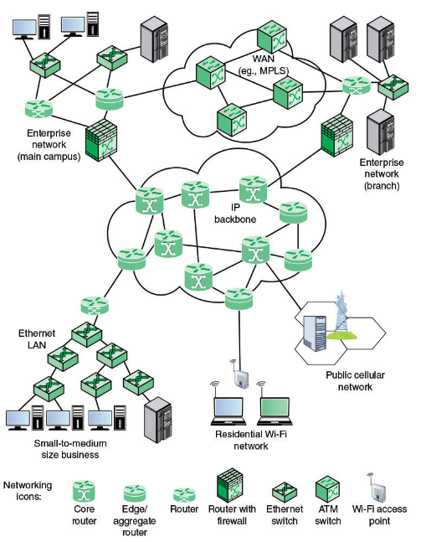
Typical network architecture (traditional and SDN)

Slide 6
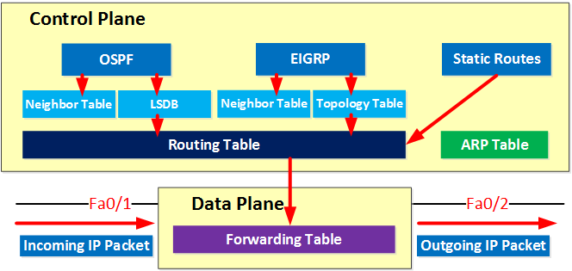
Traditional networking

Slide 7
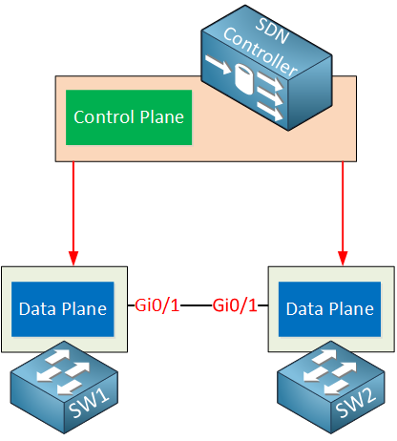
Software Defined Networking

Slide 8
SDN Core Principles
Separation of control and data plane
Programmable network behavior
Centralized network intelligence
Open interfaces (APIs) for automation
SDN makes networks “software-controllable” like cloud systems

Slide 9
SDN Architecture Overview
Infrastructure Layer – switches, routers
Control Layer – SDN controller, network OS
Application Layer – apps using network APIs

Slide 10
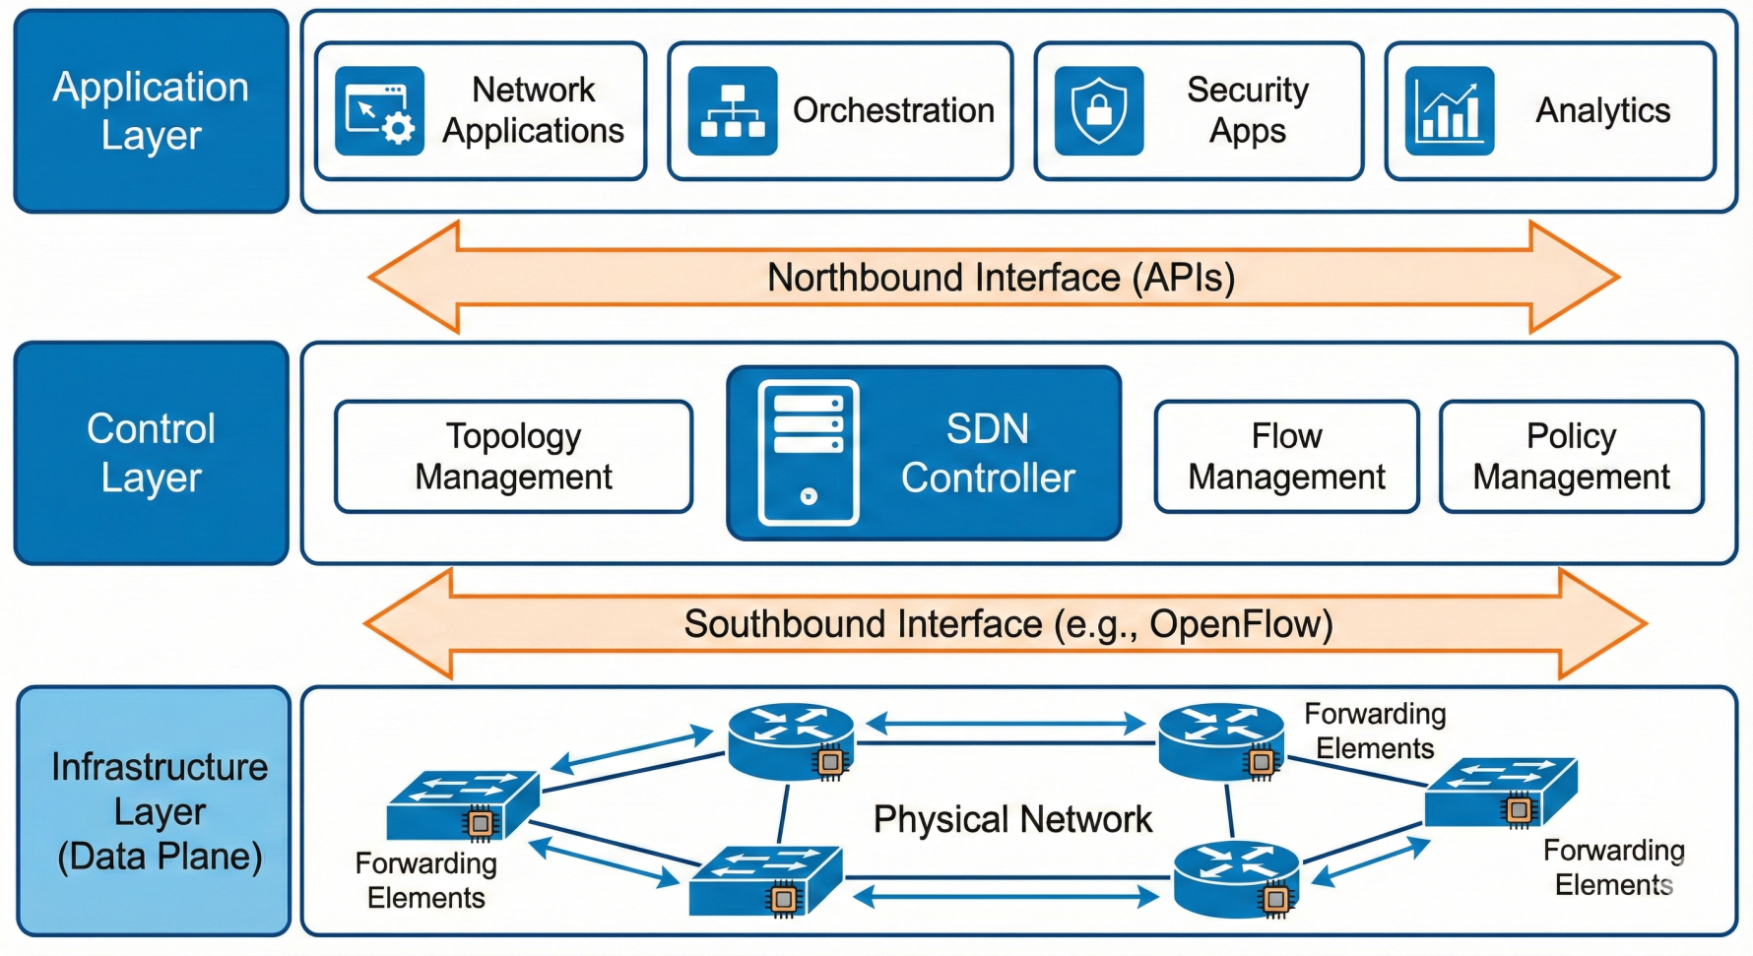
SDN architecture

Slide 11
SDN Infrastructure Layer
Physical or virtual switches
OpenFlow-capable devices
Forwarding devices execute controller instructions

Slide 12
SDN Control Layer
Centralized SDN Controller
Maintains global network view
Computes paths and distributes flow rules
Examples: ONOS, OpenDaylight, Ryu, Floodlight

Slide 13
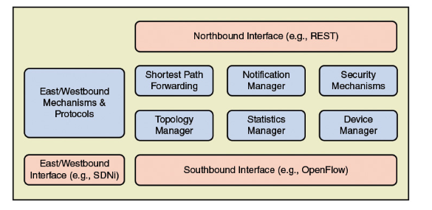
SDN Controller functions

Slide 14
SDN Application Layer
Network applications use northbound APIs
Examples:
  Traffic engineering
  Security automation
  QoS and monitoring
  apps can dynamically react to network state

Slide 15
SDN APIs
Southbound APIs: OpenFlow, NETCONF/YANG, P4Runtime
Northbound APIs: REST, intent-based interfaces, higher-level orchestration
Southbound APIs control switches; northbound API enable apps to control network

Slide 16
OpenFlow Basics
Core protocol for SDN
Flow tables in switches
Controller instructs switches on packet forwarding
Match-action rules: match packet → apply action

Slide 17
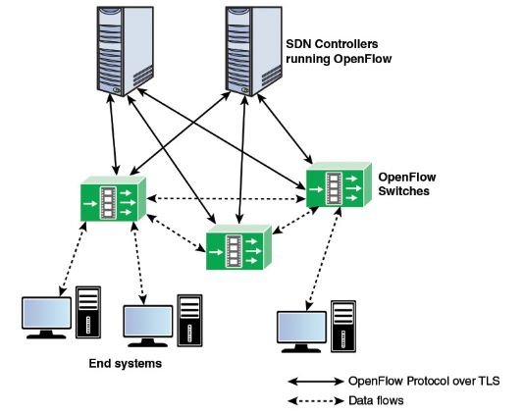
OpenFlow

Slide 18
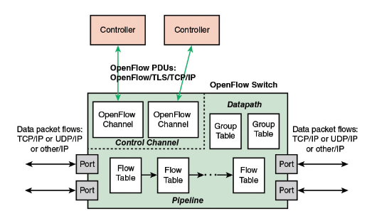
OpenFlow switch

Slide 19
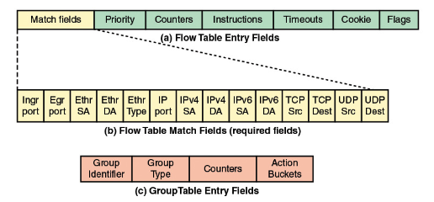
OpenFlow – FlowTable structure
Each packet entering the switch passes through one or more flow tables
Each packet is matched to a flowtable entry and sent to an egress port or to another flow table

Slide 20
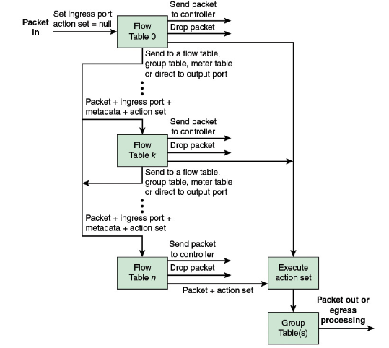
OpenFlow – Ingress processing of a packet

Slide 21
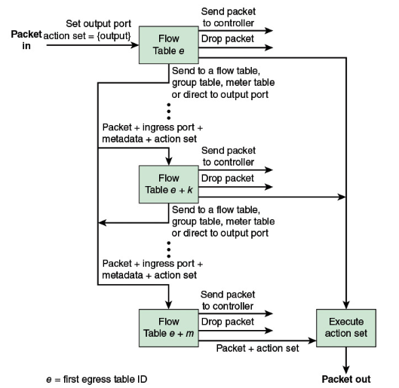
OpenFlow – Egress processing of a packet

Slide 22
Programmable Data Plane
P4 language for custom packet processing
Programmable switch pipelines
Use cases: load balancing, custom packet headers, telemetry

Slide 23
SDN Virtualization
Overlay networks: VXLAN, GRE, Geneve
NFV vs SDN – complementary concepts
Virtual switches: Open vSwitch, VPP

Slide 24
SDN Controllers
Centralized intelligence for network automation
Features: topology discovery, flow rule distribution, traffic engineering
Popular controllers: OpenDaylight, ONOS, Ryu, Floodlight

Slide 25
SDN Use Cases: Data Centers
Multi-tenant networks with isolation
Automated provisioning and scaling
East-west traffic optimization

Slide 26
SDN Use Cases: Service Providers
5G network slicing
WAN SDN for traffic optimization
Carrier-grade traffic engineering

Slide 27
SDN Use Cases: Enterprise & Campus
Centralized policy and network segmentation
Dynamic QoS for applications
Identity-based access control and security automation

Slide 28
SDN Tools & Emulation
Mininet – virtual networks for labs
GNS3 / EVE-NG – industry-grade emulation
P4 Development Tools – BMv2 switch, Tofino, P4Runtime

Slide 29
SDN Challenges
Controller scalability and consistency
Reliability and single point of failure
Security: controller attacks, API misuse
Standardization issues: multiple southbound protocols

